Slide 1

Incarcerated Women’s Perceptions of Their Best Selves in Prison: Themes & Age Variations
Hannah White, M. S.
School of Criminology & Criminal Justice
Arizona State University
hrwhite3@asu.edu

Slide 2
Positive Outcomes in Prison
Studying positive outcomes is not a novel concept
Well-being and happiness research (Diener et al., 1999; Huppert, 2009; Oishi et al., 2019)
Posttraumatic growth (Tedeschi & Calhoun, 2004)
Positive psychology (Morse et al., 2022)
Positive Criminology & Good Lives Model (GLM) (Ronel & Segev, 2015; Ward & Brown, 2004)
Narratives of reinvention & growth can be located in prisons (Helfgott et al., 2020; Maier & Ricciardelli, 2021; van Ginneken, 2015, 2016)
Posttraumatic growth in prison
Reflect & envision future self
Opportunity for productivity
Incarceration as new beginning

Slide 3
Age-Graded Corrections
Positive outcomes related to aging – purpose in life, well-being, positive affect, coping skills (Bailey,2016; Charles et al., 2001; Mroczek & Kolarz, 1998; Shook et al., 2017; Skinner & Edge, 1998)
Desistance & the age/crime curve– developmental & sociological factors (Doherty & Bersani, 2018; Laub & Sampson, 2001; Scott & Steinberg, 2008)
Identity development & human agency
Desistance as deliberate act of self-change (Paternoster & Bushway, 2009)
Identity development related to age & crime (Rocque et al., 2016)
Redemption narratives & “tragic optimism” (Maruna, 2001)
Early desistance narratives in prison – identity change in prison also related to age (Martin et al., 2019)

Slide 4
Current Study
What are the most common themes among incarcerated women’s perceptions of their best selves in prison?
Are common themes among responses invariant when grouped by age?

Slide 5
Data & Methods
Participatory Action Research (PAR)
Team of incarcerated women and ASU researchers (faculty and graduate students)
Collaboration in all stages
Designing questionnaire
Recruiting participants
Conducting interviews
ASU researchers – 101 interviews
Incarcerated interviewers – 99 interviews

Slide 6
Data & Methods
Women’s state prison in Goodyear, Arizona – medium security unit
Semi-structured interviews with 200 incarcerated women – January-April 2022
Interview questionnaire – 4 sections, open and closed-ended questions
Appreciative inquiry
Vignettes – perceptions of PAR in prison programming
Trust among women on the unit
Background information

Slide 7
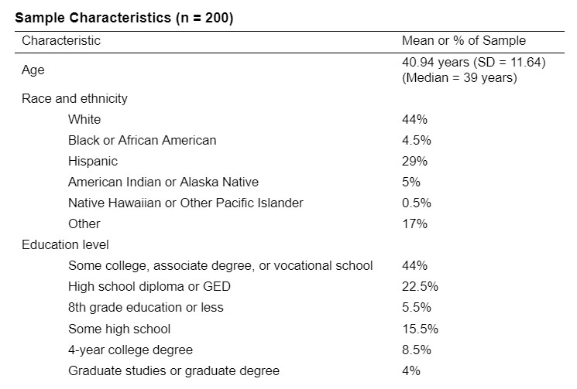
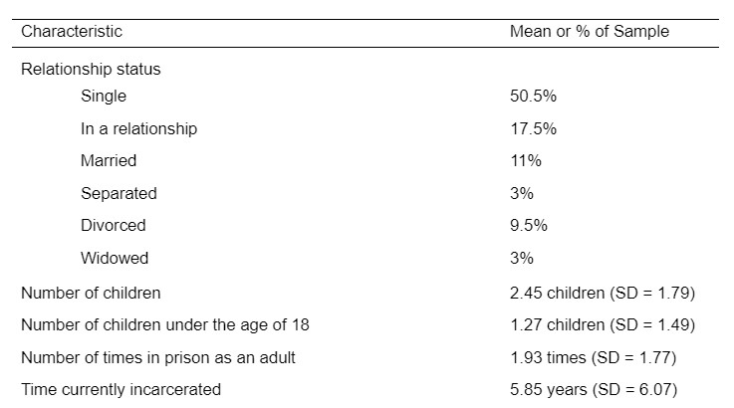

Slide 8
Measures & Analysis
Best Self Perception – “Tell me a story about a time you were at your best in here in the last couple of weeks.”
Age – “How old are you?”
Young adulthood (ages 20-35, n = 71)
Middle adulthood (ages 36-49, n = 87)
Late adulthood (ages 50-83, n = 42)
Analysis
Thematic analysis using Atlas.ti (intercoder agreement = 84%)
Frequencies of themes and sub-themes across all 200 responses
Frequencies of themes when grouped by adulthood life stages

Slide 9
What are the most common themes among incarcerated women’s perceptions of their best selves in prison?
Personal Growth (51%, n = 102)
Practicing maturity
Physical health & wellness
Pride in accomplishments
Positive attitude
Employment (25%, n = 50)
Working (in general)
Performing well at job
Interviewing for or starting new job
Perseverance
Religion & spirituality
Recovery & sobriety
Life skills
“Every day you have to find a way to face the struggles and challenges in here.”
“I‘m always at my best when I’m working. I’ve never worked this hard before.”
Healthy Relationships (18%, n = 36)
Relationships with children
Family relationships
Relationships with other women on the inside
Communication with the outside
“Nothing could ruin that day… having my daughter is the one thing in life that I don’t regret.”

Slide 10
What are the most common themes among incarcerated women’s perceptions of their best selves in prison?
Incarceration Experience (17.5%, n = 35)
Appreciation or support from others
Celebrations
Case or sentence-related
Dignity & humanity
Positive experiences with staff
Hobbies & leisure
Health living situations
“It feels good to be trusted by another normal person.”
Programming & Education (17%, n = 34)
Working towards education
Participating in a program
Completing a program
Completing education
Helping & Supporting Others (16.5%,n = 33)
“I usually help people out as best I can. I don’t help people to get things in return.”
At One’s Best Every Day (4.5%, n = 9)
Not At One’s Best (3.5%, n = 7)

Slide 11
Are common themes invariant when grouped by age?
Theme
Personal Growth
Employment
Healthy Relationships
Incarceration Experience
Programming or Education
Helping & Supporting Others
At One’s Best Everyday
Not at One’s Best
Young Adulthood Ages 20-35 (n = 71)
43.7% (n = 31)
19.7% (n = 14)
16.9% (n = 12)
16.9% (n = 12)
18.3% (n = 13)
9.9% (n = 7)
4.2% (n = 3)
5.6% (n = 4)
Middle Adulthood Ages 36-49 (n = 87)
57.5% (n = 50)
29.9% (n = 26)
18.4% (n = 16)
17.2% (n = 15)
19.5% (n = 17)
16.1% (n = 14)
4.6% (n = 4)
1.1% (n = 1)
Late Adulthood Ages 50-83 (n = 42)
50% (n = 21)
23 .8% (n = 10)
19% (n = 8)
19% (n = 8)
9.5% (n = 4)
28.6% (n = 12)
2.4% (n = 1)
4.8% (n = 2)

Slide 12
Conclusions & Implications
Themes as a roadmap or guide for creating more enabling environments
Several themes were consistent across women of all ages
Specific opportunities for holistic programming
Personal Growth
Healthy Relationships
Employment
Programming & Education
Older women (middle, late adulthood) – Helping & Supporting Others
Mentorship opportunities – benefits for mentee and mentor

Slide 13
Thank you
Hannah White, M. S.
hrwhite3@asu.edu
American Society of Criminology, Atlanta, GA
November 16, 2022
12

